Slide 1

Game of words

Slide 2








CONTENTS
2.
1.
TEAM MEMBERS
TOPIC
2.
STAGES OF REALIZATION
4.
USED TECHNOLOGY
4.

Slide 3
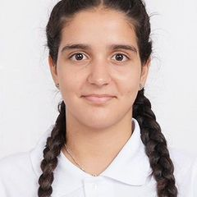
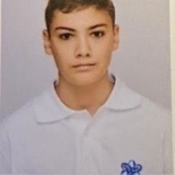
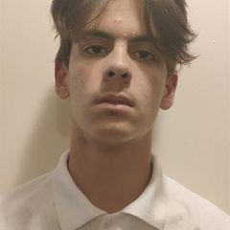
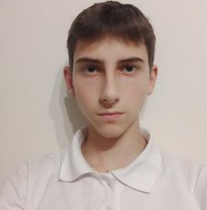
TEAM MEMBERS
Demetra Karagyozova
Boyan Kyovtorov
Dimitur Dimov
Ivan Dimov
Scrum Trainer
9g
Backend Developer
9v
QA engineer
9v
Frontend Developer
9v

Slide 4
TOPIC
The idea of the project is to create a game or program in the C++ programming language connected with game of words or math game. Our game is Hangman.
Please keep this slide for attribution

Slide 5
STAGES OF REALIZATION
1
2
3
4
Thinking of an idea
Organizing and giving everyone a role
Realization
Presenting the final result

Slide 6












USED TECHNOLOGY

Slide 7
LET’S MOVE ON TO OUR PROJECT

